Slide 1

Cryptography
CS-486
September 18th, 2017 Paul A. Lambert

Slide 2
Cryptography Monday September 18th, 2017
Logistics
Homework #4
Hashing (see shasum)
https://docs.kali.org/introduction/download-official-kali-linux-images
Using block ciphers https://crypto.stanford.edu/~dabo/courses/OnlineCrypto/slides/04-using-block-v2-annotated.pdf
Padding
Quiz
Risks, Attacks, Analysis and Mitigation
Big Numbers
Symmetric encryption properties
Authenticated Encryption
https://eprint.iacr.org/2000/025.pdf
Raspberry Pi and Kali Distribution

Slide 3
Padding
Example padding approach from:
draft-mcgrew-aead-aes-cbc-hmac-sha2-05.txt
Prior to encryption, the plaintext P is padded by appending a padding string PS to that data, to ensure that len(P || PS) is a multiple of the block_size, as is needed for the encryption operation. Pseudo code:
# encrypt pseudo python
num_blocks, remainder = divmod( plain_text, block_size)
padding_len = block_size – remainder
padding_string = pad_len * chr( pad_len)
cipher_text = block_encrypt( plain_text + padding_string )
# decrypt psuedo python
plain_text = decrypt( cipher_text)
pad_len = plain_text[:-1]
# strip padding
plain_text = plain_text[:-pad_len]

Slide 4



Risk Analysis
Risk = Vulnerability x Threat x Cost
Vulnerability: is the probability of success of an attack for a particular threat category. The “value” of vulnerability in the risk equation can vary depending on the type of attacker, for example a government may have more resources to b successful than a single hacker.
Threat: is the likelihood of an adverse event. It is based on a particular threat category (hacker, disgruntle employee, government agency)
Cost: is the impact of an attack against the vulnerability by the particular threat. Breaking into an online banking account typically has a higher cost than a denial of service attack against a single user.

Slide 5
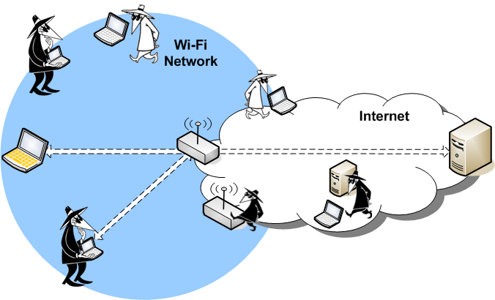
Attack Vectors
The location and capabilities of an attacker in the network is a useful way to categorize vulnerabilities.

Slide 6
Going from Risks to Recommendations
Mitigating vulnerabilities is the easiest way to reduce Risk and improve security.
Technical mechanisms
Knowing the Risk of specific scenarios allows a balanced analysis to determine which vulnerabilities need to be fixed..
Not all vulnerabilities need to be addressed for a particular application
Example – denial of service attacks

Slide 7
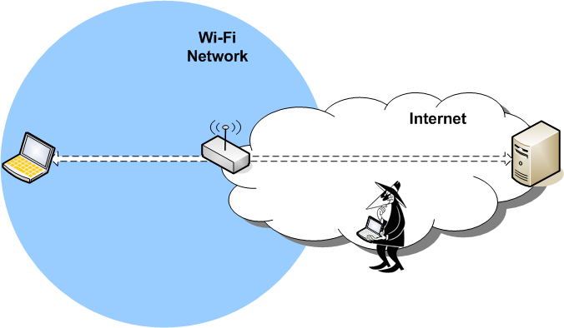
Internet Based Active Attacks
Vulnerabilities
- Default passwords
- Open ports
- Password cracking/guessing
- Stack Exploits
- viruses
- Trojan horse programs
Prevention (in AP)
- Firewall in AP
- Intrusion Detection
- virus checking
A Wi-Fi network connected to the Internet will be the target of network attacks.
Vulnerabilities
- Default passwords
- Open ports
- Password cracking/guessing
- Stack Exploits
Prevention
- Unique OOB passwords
- TLS for Management
- Strong unique authentication
- Hardened protocol stack
- Intrusion Detection

Slide 8
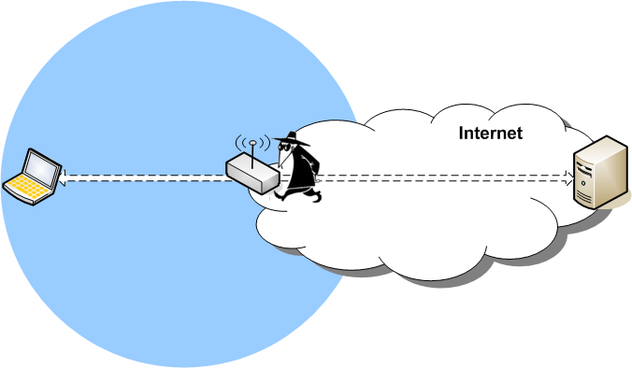
Physical Attacks on Network Equipment
Physical access to network equipment allows the device to be reset or modified.
.
Vulnerabilities
- Device reset
- WPS unauthorized join
- Disclosure of device PW or PIN on labels
- insertion of monitoring device
Prevention
- safe location - restrict access to reset
- secure reset process

Slide 9
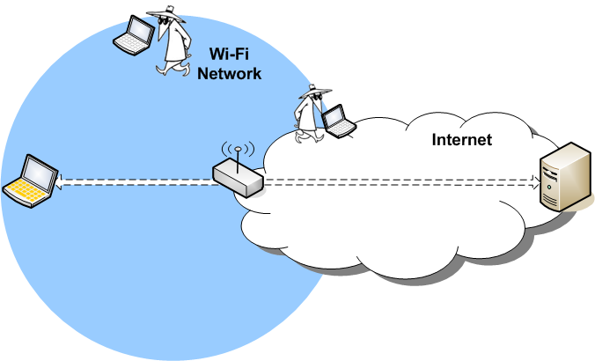
Passive Sniffing Attacks
Threat: Anyone with a computer and bad intent
Sniffing of “open” wireless communications or poorly encrypted communications (like WEP) is the most visible wireless vulnerability.
Vulnerabilities
- Wireless Sniffing
- WEP Cracking
- RSN Password Cracking
- Management Frame Monitoring
- credential capture (e.g. Firesheep)
Prevention
- Use RSN Enterprise
- Use Management Frame Protection
Threat: Governments, Service Providers, IT Department personal, but NOT usually an average hacker.
Vulnerabilities
- Backhaul or Internet
Based Monitoring
- Modification or spoofing
Prevention
- Use end-to-end security for STA traffic of value (TLS, IPsec, or other VPN)
- Use end-to-end security for AP Management Traffic (TLS, IPsec, or other VPN)

Slide 10
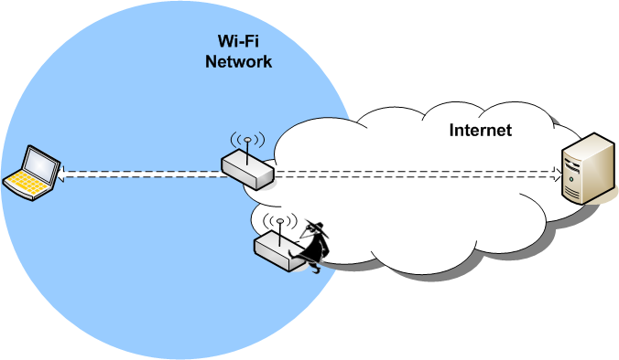
Evil Twin APs
A rogue AP tricks a user into connecting to a network controlled by the attacker.
Vulnerabilities Prevention
- SSID Confusion - intrusion detection
- open network - strong authentication
- weak or no authentication
Vulnerabilities Prevention
- Weak Authentication - STAs MUST authenticate and validate server and AP
- SSID confusion - STA UI must be clear on connection type
- activity monitoring / intrusion detection
- binding of expected service to authentication

Slide 11
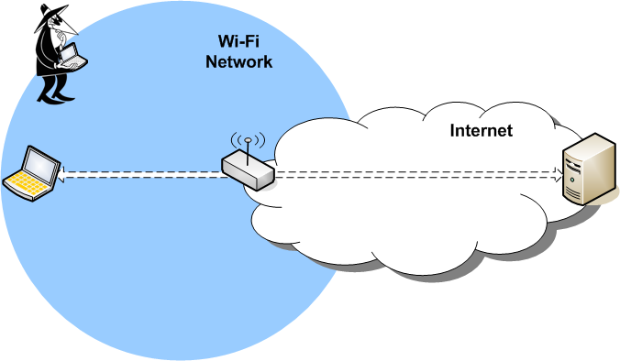
Active Wireless Attacks without Network Membership
The Attacker does NOT have keys for a secure connection, but can still cause problems.
Vulnerabilities Prevention
- Management Frame Spoofing - Use Management Frame Prot
- Wi-Fi Firmware Attacks - Vendor specific patches
- WPS 1.0 Cracking - Use WPS 2.0
- ANQP Unprotected
Vulnerabilities Prevention
- Management Frame Spoofing - Use 11w
(DoS generally used to help bump STA to Rogue device)
- Wi-Fi Firmware Attacks - Vendor specific patches
- Active key cracking - Use RSN
- 11u/GAS/ANQP Unprotected -? Is this a Risk?

Slide 12
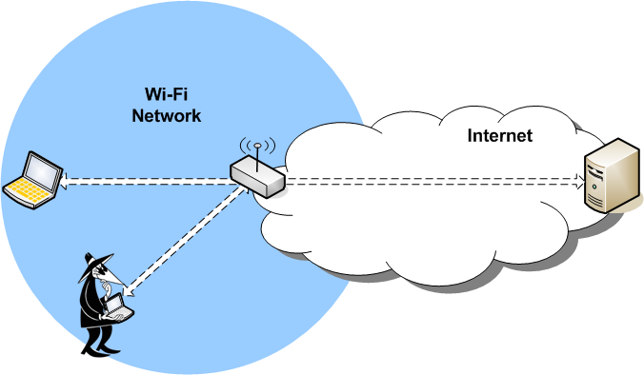
Attacks from Wi-Fi Users on the Same Secure BSS
This is a Hotspot specific attack vector. In homes, you trust your peer devices and users. In a Hotspot there is no way to prevent malicious users from connecting to the network.
Vulnerabilities
- Attack from WLAN User
- from hacker or computer worms
- Traffic Monitoring
- ARP and DNS spoofing, MIM attacks
- credential capture (e.g. Firesheep) - IPv6 neighbor discovery
Prevention
- Access network isolation of users traffic (prevent inter-BSS communications)
- Use proxy ARP

Slide 13
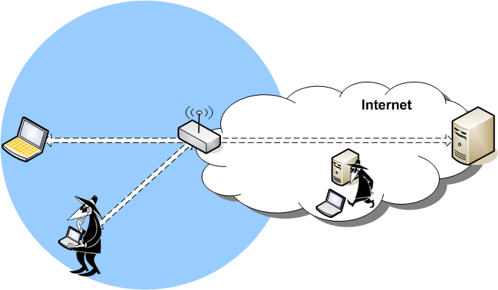
Attacks on the Same Secure BSS with AP Isolation
Vulnerabilities
- STA accepts unicast IP frame encrypted in RSN broadcast key (aka Hole 196) Allows spoofing of ARP and DNS which leads to Man-in middle attacks
Prevention (at STA)
- STA checking of key usage (not easy) (broadcast key only for broadcast traffic)
Even when a AP isolates users on a BSS there are still know vulnerabilities for Hotspots.
Vulnerabilities
- Broadcast key shared by all users
Prevention (at AP)
- Don’t distribute a shared broadcast key
2
Threat: Anyone with a computer and bad intent anywhere on the Internet (and an accomplice at the Hotspot)
1
IEEE 802.11 Recommendations: - AP optionally may NOT distribute a shared broadcast key
- STA should check broadcast key usage

Slide 14
Encryption Attacks
CPA - Chosen Plaintext Attack
An attacker can obtain the ciphertext for any provided plaintext (but does not have the key).
CCA - Chosen Ciphertext Attack
An attacker can also, in addition to being able to perform a CPA, obtain the plaintext for any provided ciphertext (but does not have the key).

Slide 15
Indistinguishability and Non-Malleability
IND - Indistinguishability
The advantage of a reasonable adversary determining what message was sent,
IND-CPA - Indistinguishability under a Chosen Plaintext Attack
IND-CCA - Indistinguishability under a Chosen Ciphertext Attack
INT - Integrity
INT-PTXT - Computationally infeasible to produce a ciphertext decrypting to a message which the sender has never encrypted
INT- CTXT – Computationally infeasible to produce a ciphertext not previously produced by the sender, regardless of whether or not the underlying plaintext is “new”
NM - Non-malleability
Is the advantage of a reasonable adversary being able to change the message to be meaningful
NM-CPA - Non-malleability under a Chosen Plaintext Attack
NM-CCA - Non-malleability under a Chosen Ciphertext Attack
WUF - Weakly unforgeable MAC
An attacker (with the capability of making chosen message attacks) is incapable of creating a new accepted message and tag pair (the message cannot have previously been queried).
SUF - Strongly unforgeable MAC
An attacker (with the capability of making chosen message attacks) is incapable of creating a new accepted message and tag pair (the tag cannot have previously been returned in response to a query - but the message may have been queried).
https://www.cs.jhu.edu/~astubble/dss/notes3c.pdf
http://cseweb.ucsd.edu/~mihir/papers/oem.pdf

Slide 16
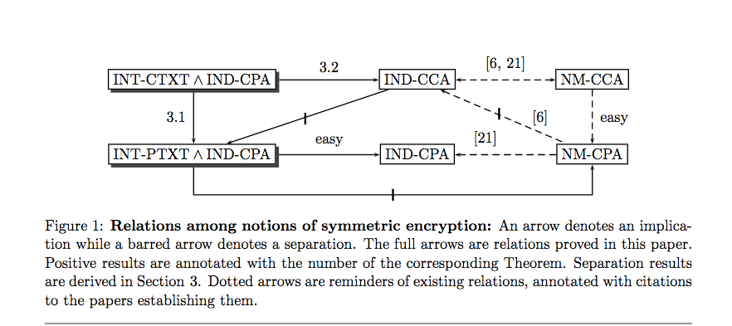
Symmetric Encryption ‘Notions’
Authenticated Encryption: Relations among notions and analysis of the generic composition paradigm, Mihir Bellare, Chanathip Namprempre July 14, 2007

Slide 17
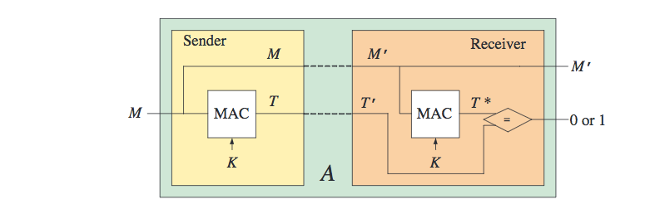
Message Authentication Codes
MAC algorithm standards :
FIPS PUB 113 Computer Data Authentication (DES based, withdrawn in 2002)
RFC 2104 & FIPS PUB 198-1 The Keyed-Hash Message Authentication Code (HMAC)
ISO/IEC 9797-1 Mechanisms using a block cipher
ISO/IEC 9797-2 Mechanisms using a dedicated hash-function
Message Authentication Codes
http://cseweb.ucsd.edu/~mihir/cse207/w-mac.pdf

Slide 18
Block Ciphers and Hashing
HW4
Write a Python command-line program to:
encrypt or decrypt a file using a contemporary block cipher
Pick a ‘good’ mode of operation
consider how to protect the key used for the encryption
Write a Python command-line program to:
Hash a file using at least two contemporary hash algorithms

Slide 19
Backup Material

Slide 20
Logistics for Class
Canvas CS-486-01
Primary repository for grading
URL for all homework submittals must be ‘linked’ into the appropriate Canvas assignment!
Github: https://github.com/CryptoUSF
Course material, class presentations, references, books
Sample code for assignments: https://github.com/CryptoUSF
Private student repositories,
too many if one per assignment per student
Wiki for additional class information and assignements
Piazza: CS486
Informal class conversations

Slide 21
Additional References
Courses:
https://crypto.stanford.edu/~dabo/courses/OnlineCrypto/
http://cseweb.ucsd.edu/~mihir/cse207/
Conferences:
Real World Cryptography
https://www.iacr.org
Mailing Lists and Standards:
http://csrc.nist.gov US Federal security specifications
https://trac.ietf.org/trac/sec/wiki Internet security standards
https://irtf.org/cfrg Internet cryptographic research

Slide 22
File Encryption with Classic Ciphers
HW1
Write a Python command-line program to encrypt or decrypt a file.
The program should: - provide command to encrypt or decrypt a file - provide option flags to select the algorithm to use for encryption or decryption - multiple simple ciphers should be implemented and should include: - the Caesar Cipher - another simple substitution cipher - a poly-alphabetic cipher - a transposition cipher For every algorithm you implement, please include a description of the algorithm in the docstring and a reference to the source description of the algorithm. References should be wherever possible to historic text for these older algorithms. A list of books are in Canvas for such references.
Example solution code for assignment: https://github.com/CryptoUSF/CS486/blob/master/code/cipher.py
Existing python library reference: pycipher

Slide 23
Cryptanalytic Toolkit
HW2
Write a cryptanalytic toolkit in Python to analyze the statistical properties of files.
Determine the frequency distribution of characters in an arbitrary string. Print out the Monogram distribution of the characters.
Determine the Bigram, Trigram or higher distribution of symbols in a file.
Example solution code for assignment: https://github.com/CryptoUSF/CS486/blob/master/code/cipher.py

Slide 24
Prime Numbers
HW3
Review section 4.2 of the “Handbook of Applied Cryptography” [HAC]. Closely read section 4.2.3 (Rabin-Miller)
Complete the ‘is_prime’ routine in: https://github.com/CryptoUSF/CS486/blob/master/code/prime.py
Your goal is to understand the nature of generating ‘good’ prime numbers. You should understand the implications of the selection of the number of iterations of the Rabin-Miller algorithm. This is a useful routine that you should write to a ‘production grade’. Look at other references and worked code example for the best way to select the number and value of the witness numbers.

Slide 25
Block Ciphers and Hashing
HW4
Write a Python command-line program to:
Encrypt or decrypt a file using a contemporary block cipher
Pick a ‘good’ mode of operation
Consider how to protect the key used for the encryption
Write a Python command-line program to:
Hash a file using at least two contemporary hash algorithms

Slide 26
Raspberry Pi
We will use a Raspberry Pi to get experience using contemporary analysis ‘tools’
Raspberry Pi
Excellent reference for what to acquire and how to setup:http://rpi.cs.usfca.edu/2017-fall
The first Pi project will use cryptographic related tools that are available in the Kali distribution: https://www.kali.org/
The tools do not necessarily require the Kali OS distribution and you may be able to simply install some of the tools on an existing Raspberry Pi OS installation.

Slide 27
Python References
Python Documentation (Python Web Site)
Transforming Code into Beautiful, Idiomatic Python (video)
Functional programming in Python
Writing Awesome Command-Line Programs in Python
Building Command Line Applications with Click
Look at repositories for Python crypto implementations and read the code.

Slide 28
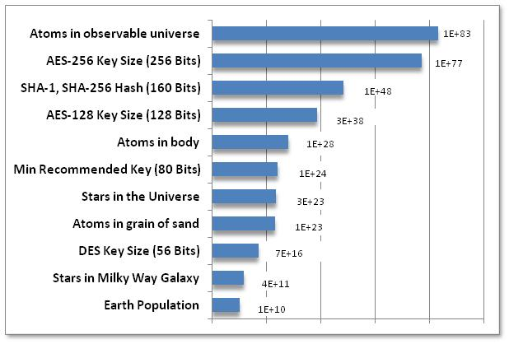
Very Big Numbers
“Astronomy has long been humanity's go-to subject when it comes to contemplating the truly enormous. But actually, if 2¹²⁸ is so much more vast than the number of stars in the observable universe (10¹⁵ times more vast*, or 4,000,000,000,000,000 in long-hand notation), then even the name "astronomical" is rather inadequate.”
-- from Economist
http://www.economist.com/blogs/johnson/2011/01/big_numbers

